Slide 1
Overfitting and Underfitting
Overfitting and underfitting are two common issues that can affect the performance of a machine learning model.

Slide 2
Over-Fitting
Overfitting occurs when the model is too complex and fits the training data too closely, resulting in poor generalization to new data. Overfitting can be caused by high variance and high bias. A model with high variance is sensitive to small fluctuations in the training data and may fit the training data too closely, leading to poor performance on new data. A model with high bias is unable to fit the training data well and may perform poorly on both the training and test sets.

Slide 3
Underfitting
Underfitting occurs when the model is too simple and cannot capture the underlying pattern in the data, resulting in poor performance on both the training and test sets. Underfitting can be caused by high bias and low variance. A model with high bias is unable to fit the training data well and may perform poorly on both the training and test sets.

Slide 4
Bias and Variance
In regression, bias and variance are two types of error that can affect the performance of a model.
Bias refers to the difference between the average prediction of a model and the true value of the target. A model with high bias is prone to underfitting, which means that it does not capture the underlying pattern in the data and performs poorly on both the training and test sets.
Variance refers to the variability of the model's predictions for a given input. A model with high variance is prone to overfitting, which means that it fits the training data too closely and performs poorly on new data.

Slide 5
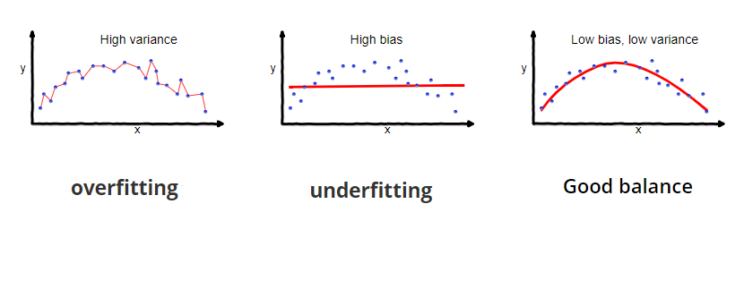
Continue…

Slide 6
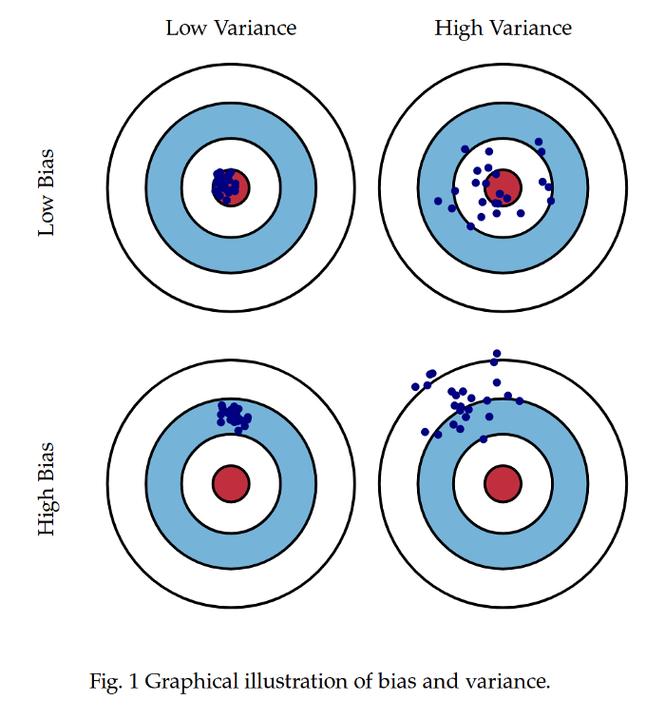
Graphical Representation

Slide 7
How to overcome Underfitting and overfitting?
To address overfitting and underfitting, you can try the following techniques:
Use regularization: Regularization is a technique that adds a penalty to the model's complexity to prevent overfitting.
Reduce the number of features: Removing unnecessary or correlated features can reduce the model's complexity and prevent overfitting.
Increase the size of the training set: Increasing the size of the training set can help the model generalize better because it will have more data to learn from.
Use cross-validation: Cross-validation is a technique that divides the training set into multiple folds and uses each fold as a test set to evaluate the model's performance. This can help identify overfitting and improve the model's generalization.

Slide 8
How to overcome Underfitting and overfitting?
Use different models: Trying different models with different architectures and parameters can help identify the model that performs best for the data.
Reduce the number of features
Manually select features
Model selection

Slide 9
Manual feature selection
Manual feature selection is the process of manually selecting a subset of features from the original dataset to use in a machine learning model. This can be done through domain knowledge or by examining the correlations between the features and the target.
There are several approaches to manual feature selection:
Forward selection: This involves starting with an empty set of features and adding one feature at a time, based on some criterion such as the improvement in model performance. The process is repeated until no further improvement is achieved.
Backward selection: This involves starting with the full set of features and removing one feature at a time, based on some criterion such as the decrease in model performance. The process is repeated until no further improvement is achieved.
Recursive feature elimination: This involves recursively removing features, building the model using the remaining features, and selecting the best performing features. The process is repeated until the desired number of features is reached.

Slide 10
Manual feature selection
Interpretation:
Manual feature selection can be time-consuming and may not always yield the best results. It is important to carefully evaluate the impact of the selected features on the performance of the model. In some cases, manually selecting a subset of features may lead to a decrease in performance, while in other cases it may improve the performance of the model.

Slide 11
Model-based feature selection
Model-based feature selection is a method of selecting a subset of features for a machine learning model using the model itself as a criterion. This is different from manual feature selection, which involves manually selecting features based on domain knowledge or correlations with the target.
Interpretation:
Model-based feature selection can be an effective way to select a subset of features that are most relevant to the problem at hand. It is important to carefully evaluate the impact of the selected features on the performance of the model. In some cases, model-based feature selection may lead to a decrease in performance, while in other cases it may improve the performance of the model.

Slide 12
Regularization:
Regularization works on assumption that smaller weights generate simpler model and thus helps avoid overfitting.
𝑓(𝑥𝑖)=𝜃0+𝜃1𝑥1+𝜃2𝑥22+𝜃3𝑥33+𝜃4𝑥44

Slide 13
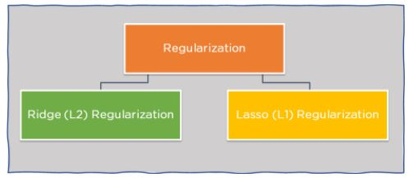
Techniques:

Slide 14
Ridge Regularization (R1):
Also known as Ridge Regression, it modifies the over-fitted or under fitted models by adding the penalty equivalent to the sum of the squares of the magnitude of coefficients.
This means that the mathematical function representing our machine learning model is minimized and coefficients are calculated. The magnitude of coefficients is squared and added. Ridge Regression performs regularization by shrinking the coefficients present.
In the cost function, the penalty term is represented by Lambda λ. By changing the values of the penalty function, we are controlling the penalty term. The higher the penalty, it reduces the magnitude of coefficients. It shrinks the parameters. Therefore, it is used to prevent multicollinearity, and it reduces the model complexity by coefficient shrinkage

Slide 15
Lasso Regression (R2):
It modifies the over-fitted or under-fitted models by adding the penalty equivalent to the sum of the absolute values of coefficients.
Lasso regression also performs coefficient minimization, but instead of squaring the magnitudes of the coefficients, it takes the true values of coefficients. This means that the coefficient sum can also be 0, because of the presence of negative coefficients.

Slide 16
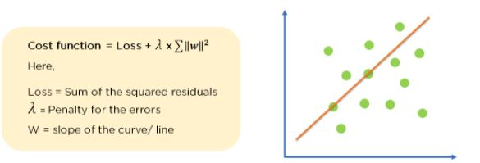
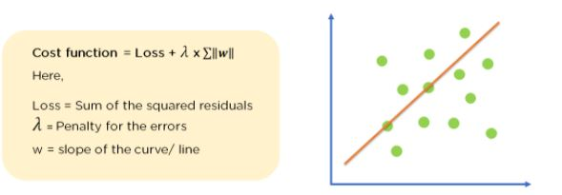
Maths behind R1 and R2

Slide 17
Continue….
𝜆≥0 maintains the trade-off between regularizer and the original loss function as it controls the relative importance of the regulrization term.
λ is the penalty term or regularization parameter which determines how much to penalizes the weights
When λ is zero then the regularization term becomes zero. We are back to the original Loss function
When λ is large, we penalizes the weights and they become close to zero. This results is a very simple model having a high bias or is underfitting.

Slide 18
Cross Validation
Cross-validation is a powerful method to prevent overfitting. The idea of cross-validation is to divide our training dataset into multiple mini train-test splits. Each split is called as a fold. We divide the train set into k folds, and the model is iteratively trained on k-1 folds, and the remaining 1 fold is used as a test fold. Based on the model performance on the test fold, we tune its hyperparameters. This allows us to tune the hyperparameters with only our original training dataset without any involvement of the original test dataset.

Slide 19
Key Difference between L1 and L2:
The key difference between these two is the penalty term. Ridge regression adds “squared magnitude” of coefficient as penalty term to the loss function.Lasso Regression (Least Absolute Shrinkage and Selection Operator) adds “absolute value of magnitude” of coefficient as penalty term to the loss function.
The key difference between these techniques is that Lasso shrinks the less important feature’s coefficient to zero thus, removing some feature altogether. So, this works well for feature selection in case we have a huge number of features.
Ridge regression is mostly used to reduce the overfitting in the model, and it includes all the features present in the model. It reduces the complexity of the model by shrinking the coefficients. Lasso regression helps to reduce the overfitting in the model as well as feature selection.

Slide 20
Polynomial Regression
If the relationship between the inputs and output is not linear, we can use a polynomial to model the relationship
The dataset used in Polynomial regression for training is of non-linear nature.

Slide 21
Continue….
Model is a polynomial function of the input, that is, 𝑓̂ (𝑥,𝜃)=𝜃0+𝜃1𝑥+𝜃2𝑥2+....+𝜃𝑖𝑥𝑀=∑𝑖=0𝑀𝜃𝑖𝑥𝑖

Slide 22
M is the degree of polynomial; characterized by 𝑀+1M+1 coefficients 𝜃0,𝜃1,𝜃2,.....,𝜃𝑀θ0,θ1,θ2,.....,θM
𝑀M is the Hyper-Parameter of the model and determines the complexity of the model. For 𝑀=1M=1, we have a linear regression.
We can use linear regression to find these coefficients by formulating the input 𝑥x and its powers using a vector-valued function given by
𝐠(𝑥)=[1,𝑥,𝑥2,𝑥3,....,𝑥𝑀]𝑇g(x)=[1,x,x2,x3,....,xM]T
With this notation , we can formulate model as
𝑓̂ (𝑥,𝜃)=𝐠(𝑥)𝑇𝜃f^(x,θ)=g(x)Tθ
Note that the model is linear in terms of parameters due to which ploynomial regression is termed as Linear in Parameters Regression.
Note that 𝐠(𝑥)g(x) can be any function of 𝑥x. For example, we can have
𝐠(𝑥)=[1𝑥,𝑠𝑖𝑛(2𝜋𝑥),𝑥2,𝑒𝑥,....]𝑇g(x)=[1x,sin(2πx),x2,ex,....]T
For 𝑛n data points(input, output), we can define residual error in a similar way we computed for linear regression as follows:

Slide 23
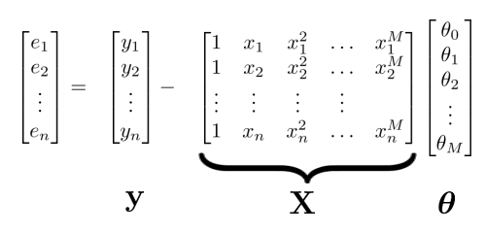
𝑤ℎ𝑒𝑟𝑒 𝑒=𝑦−𝑋𝜃

Slide 24
We observe a real-valued input variable x and we wish to use this observation to predict the value of a real-valued target variable t or 𝑓(𝑥)=𝑠𝑖𝑛(2𝜋𝑥) .
We use synthetically generated data from the function sin(2πx) with random noise included in the target values.
A small level of random noise having a Gaussian distribution
We have a training set comprising N observations of x, written 𝑥≡(𝑥1,...,𝑥𝑁)𝑇 , together with corresponding observations of the values of f(x), denoted 𝑓(𝑥)≡(𝑓(𝑥1),...,𝑓(𝑥𝑁)𝑇 .
Our goal is to predict the value of t for some new value of x
Model: 𝑓̂ (𝑥,𝜃)=𝜃0+𝜃1𝑥+𝜃2𝑥2+....+𝜃𝑖𝑥𝑀

Slide 25
Continue…
The values of the coefficients will be determined by fitting the polynomial to the training data.
This can be done by minimizing an error function that measures the misfit between the function 𝑦(𝑥,𝐰) or 𝑓̂ (𝑥,𝜃) , for any given value of 𝑤 , and the training set data points.
We can solve the curve fitting problem by choosing the value of w for which 𝐿(𝑤) or 𝐿(𝜃)is as small as possible.
Since the error function is a quadratic function of the coefficients w, its derivatives with respect to the coefficients will be linear in the elements of w, and so the minimization of the error function has a unique solution, denoted by 𝑤∗ or 𝜃∗.
The resulting polynomial is given by the function 𝑦(𝑥,𝑤∗) or 𝑓̂ (𝑥,𝜃∗).

Slide 26
continue
The polynomial degree M is the hyper-parameter of our model, like we had k in kNN, Solution 2: Take more data points to avoid over-fittingand controls the complexity of the model.

Slide 27
Polynomial Regression : How to Handle Overfitting?
The polynomial degree M is the hyper-parameter of our model, like we had k in kNN, Solution 2: Take more data points to avoid over-fittingand controls the complexity of the model.
The 0𝑡ℎ order (M=0) and first order (M=1) polynomials give rather poor fits to the data and consequently rather poor representations of the function sin(2πx).
The third order (M=3) polynomial seems to give the best fit to the function sin(2πx) of the examples.
When we go to a much higher order polynomial (M=9), we obtain an excellent fit to the training data.
In fact, the polynomial passes exactly through each data point means we have zero residual error , that is , 𝐿(𝑤∗)=0 or 𝐿(𝜃∗)=0 .
If we stick with M=3 model, this is the restriction on the number of parameters.
We encounter overfitting for M=9 because we do not have sufficient data.

